Slide 1
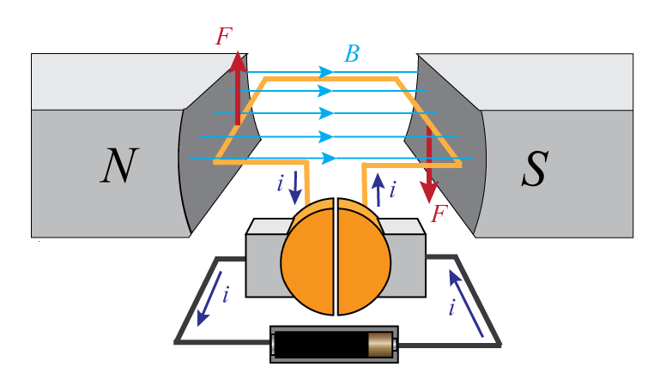
Lecture 10: DC Motors
Modeling of DC motors
Transmitting and converting motion (gear trains)

Slide 2
DC Motor
Armature-controlled DC motor model
Model resistance and inductance of the coil as lumped parameters
Same with mechanical inertia and friction
θ

Slide 3
DC Motor
Armature-controlled DC motor model
From Lorentz’s law
where K is the motor torque constant
From Faraday’s law
where K_{b} is the back emf constant
θ
Notes:
Variables different than in previous class

Slide 4
DC Motor
Armature-controlled DC motor model
Electrical domain:
Mechanical domain:
Two domains are
coupled by the previous relations
θ
Notes:
Often the contribution of the inductance is small compared to the contribution of the resistance

Slide 5
Example
Find the transfer function Θ(s)/E_{a}(s)
Notes:
Can look at from the perspective of different inputs, outputs (torque control, speed control)
Control often achieved with PWM

Slide 6
Example (continued)

Slide 7
DC Motor
In steady state
Slope is constant
Intercept changes with e_{a}
T
T_{stall}
torque
e_{a1}
e_{a2}
ω_{no-load}
ω
speed
Notes:
Slope is constant, intercept changes with applied voltage, gives some indication of how control can be achieved
In metric units K and Kb have the same units and are equal
In practice the maximum torque is limited, otherwise the currents would be extremely high and would damage the motor … though can operate above the rated limit for short amounts of time … won’t overheat if done only in short bursts

Slide 8
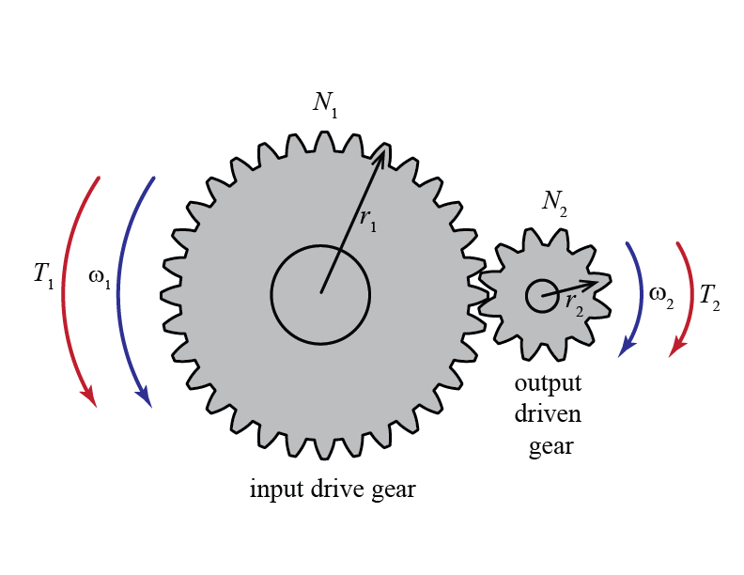
Transmitting and Converting Motion
Gears can be used to convert the speed and direction of motion, and modify the magnitude of transmitted torque
Notes:
Spur gear
Bevel gear
Rack and pinion

Slide 9
Simple Gear Train
Gears mesh without slipping, therefore,
and
Notes:
Kinematic relationship

Slide 10
Simple Gear Train
Furthermore, if friction losses are neglected, then the transmitted power is unchanged
which leads to
tradeoff between speed and torque

Slide 11
Complex Gear Train

Slide 12
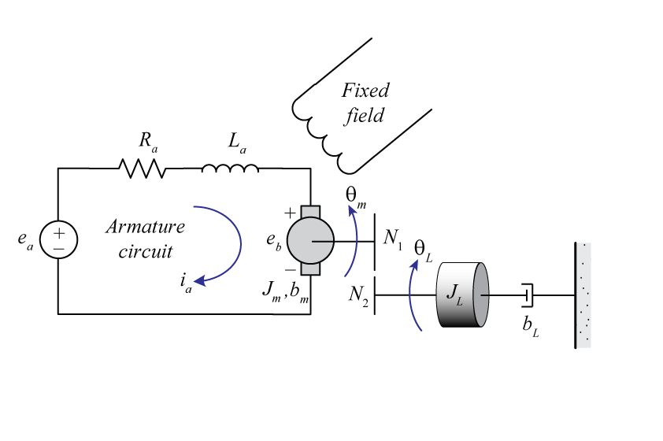
Example
Find the transfer function Θ_{L}(s)/E_{a}(s)
Notes:
Components are underneath
Make sure to include units

Slide 13
Example (continued)
Notes:
Components are underneath
Make sure to include units

Slide 14
Example (continued)
Notes:
Components are underneath
Make sure to include units

